Slide 1

Flexport Analytical Report
Haoyuan(Michael) Huang

Slide 2
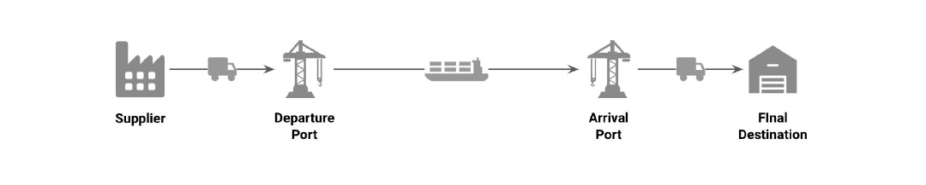
Background
Flexport manages the complexity of shipment processes and dedicated to provide a good transportation experience for clients.
The basic business model is below:

Slide 3
Business Issue
Flexport aims to provide its clients with fast, reliable, on-time deliveries at low cost.
The keywords are fast deliveries and low cost.

Slide 4
Analytical Approach
Extract and understand key insights
Create hypothesis and questions
Data manipulation and data visualization
Summary and findings

Slide 5
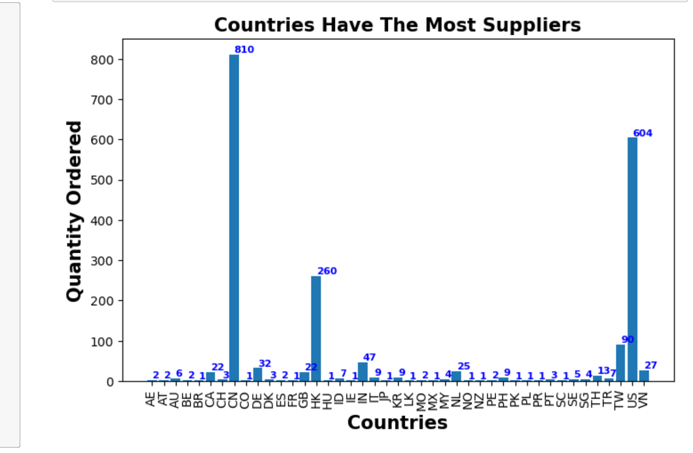
Question 1: which country has the largest suppliers?

Slide 6
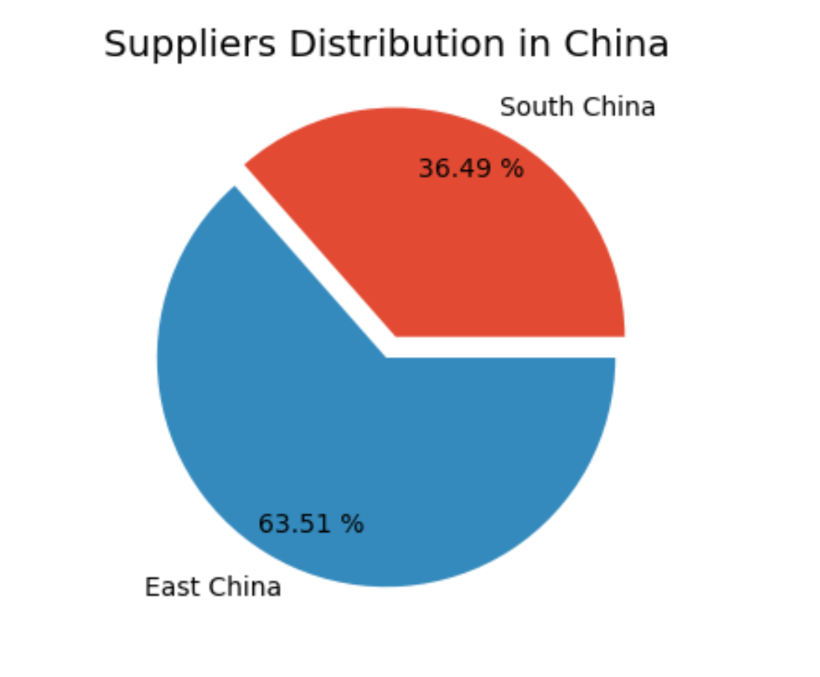
Since China is the largest supplier, I would like to know the suppliers distribution in China

Slide 7
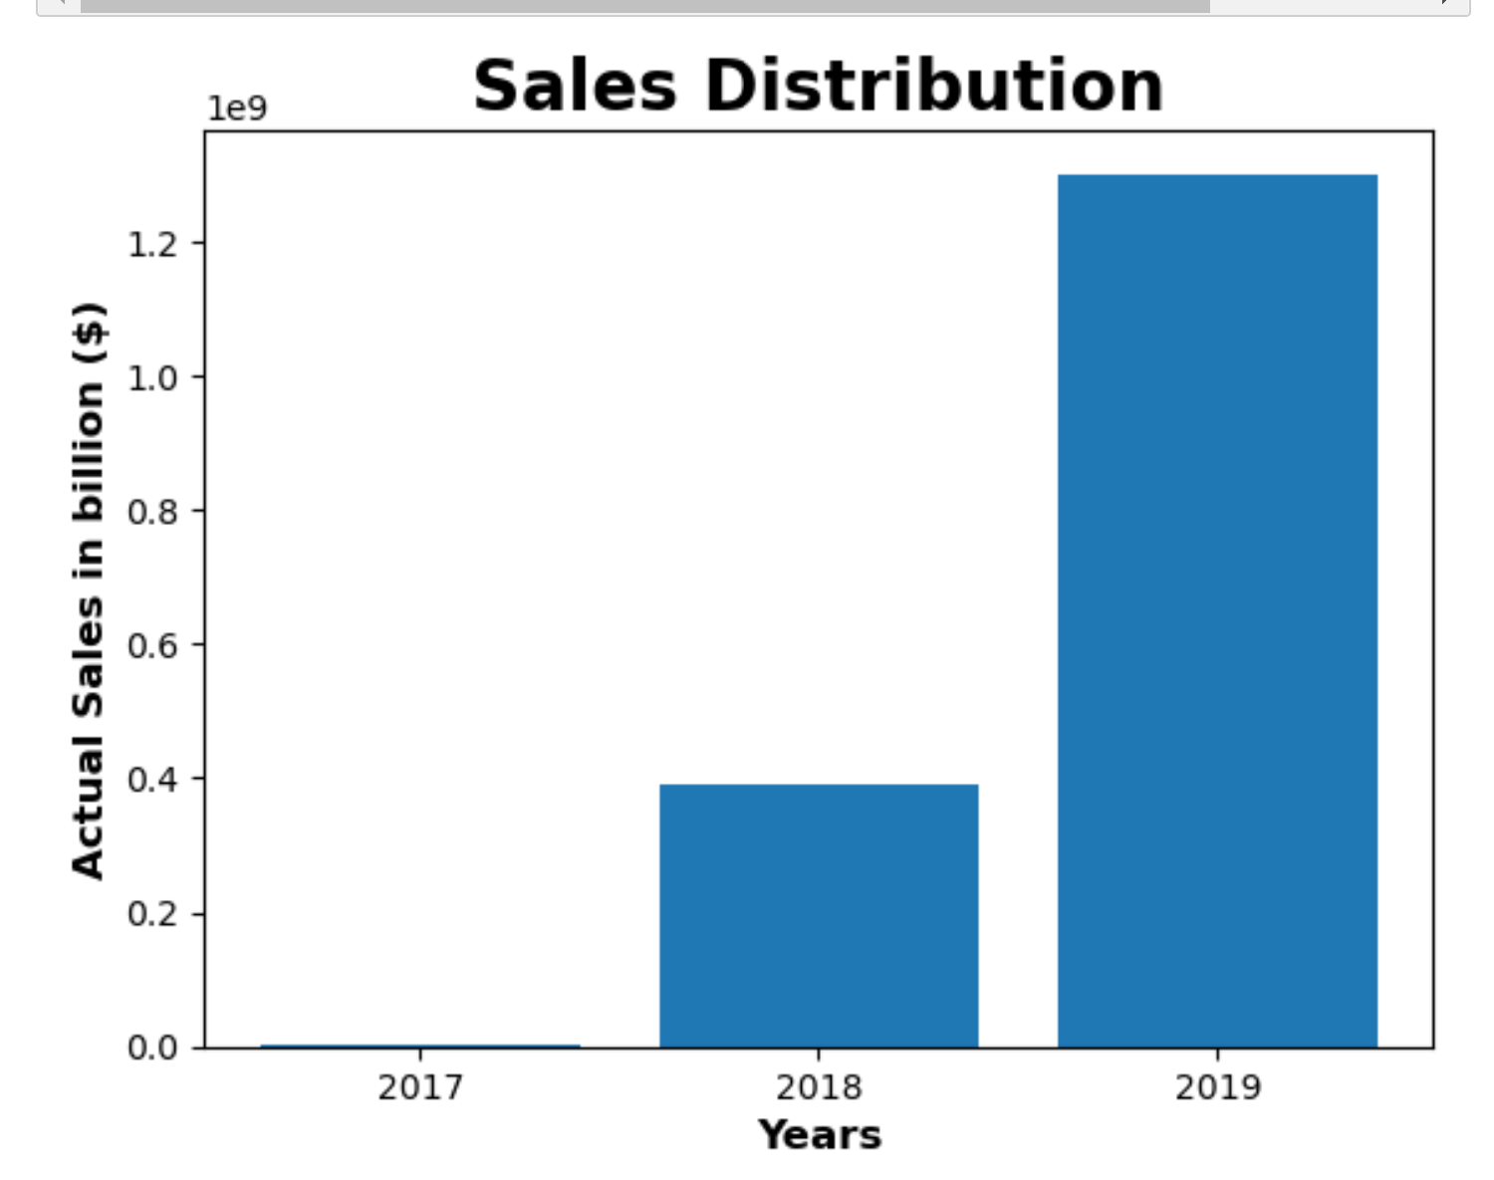
Question 2: What was the best year for sales? How much was earned?

Slide 8
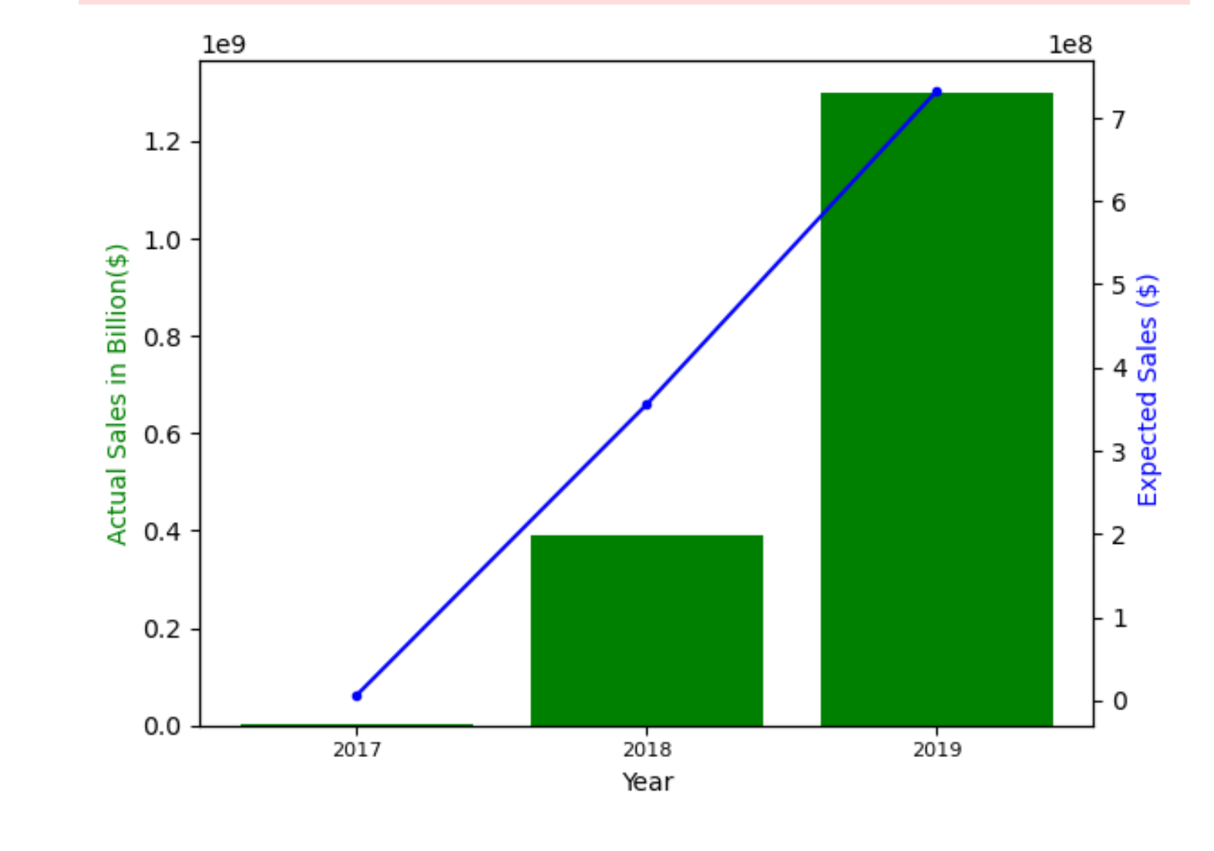
Hypothesis: The more expected sales will lead to more actual sales¶

Slide 9
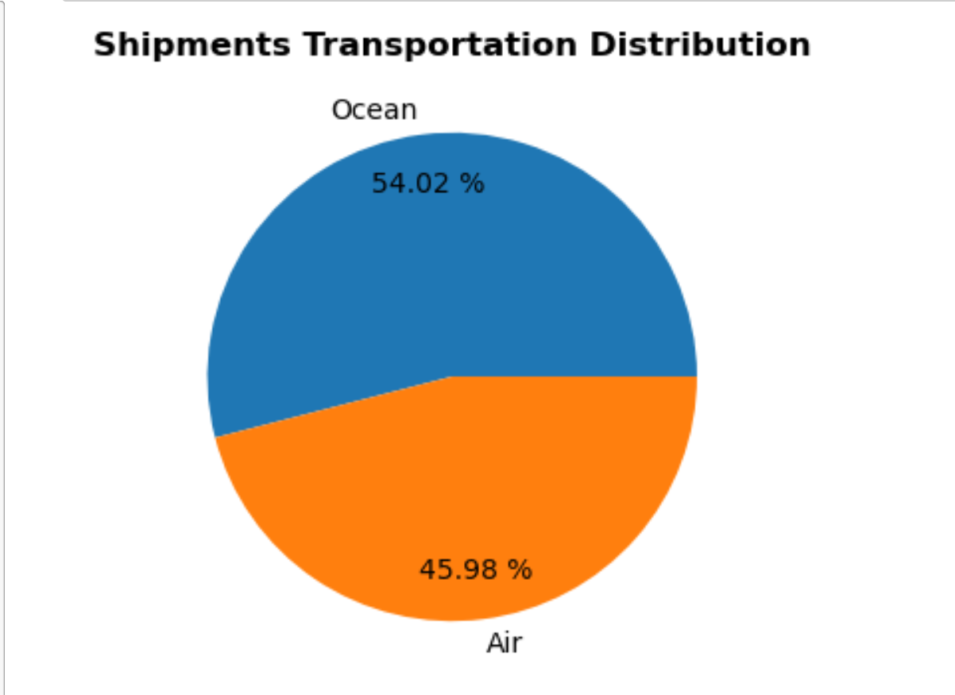
Question 3: what is the proportion of shipment? For Ocean shipments, what are the factors will affect the utilities of containers

Slide 10
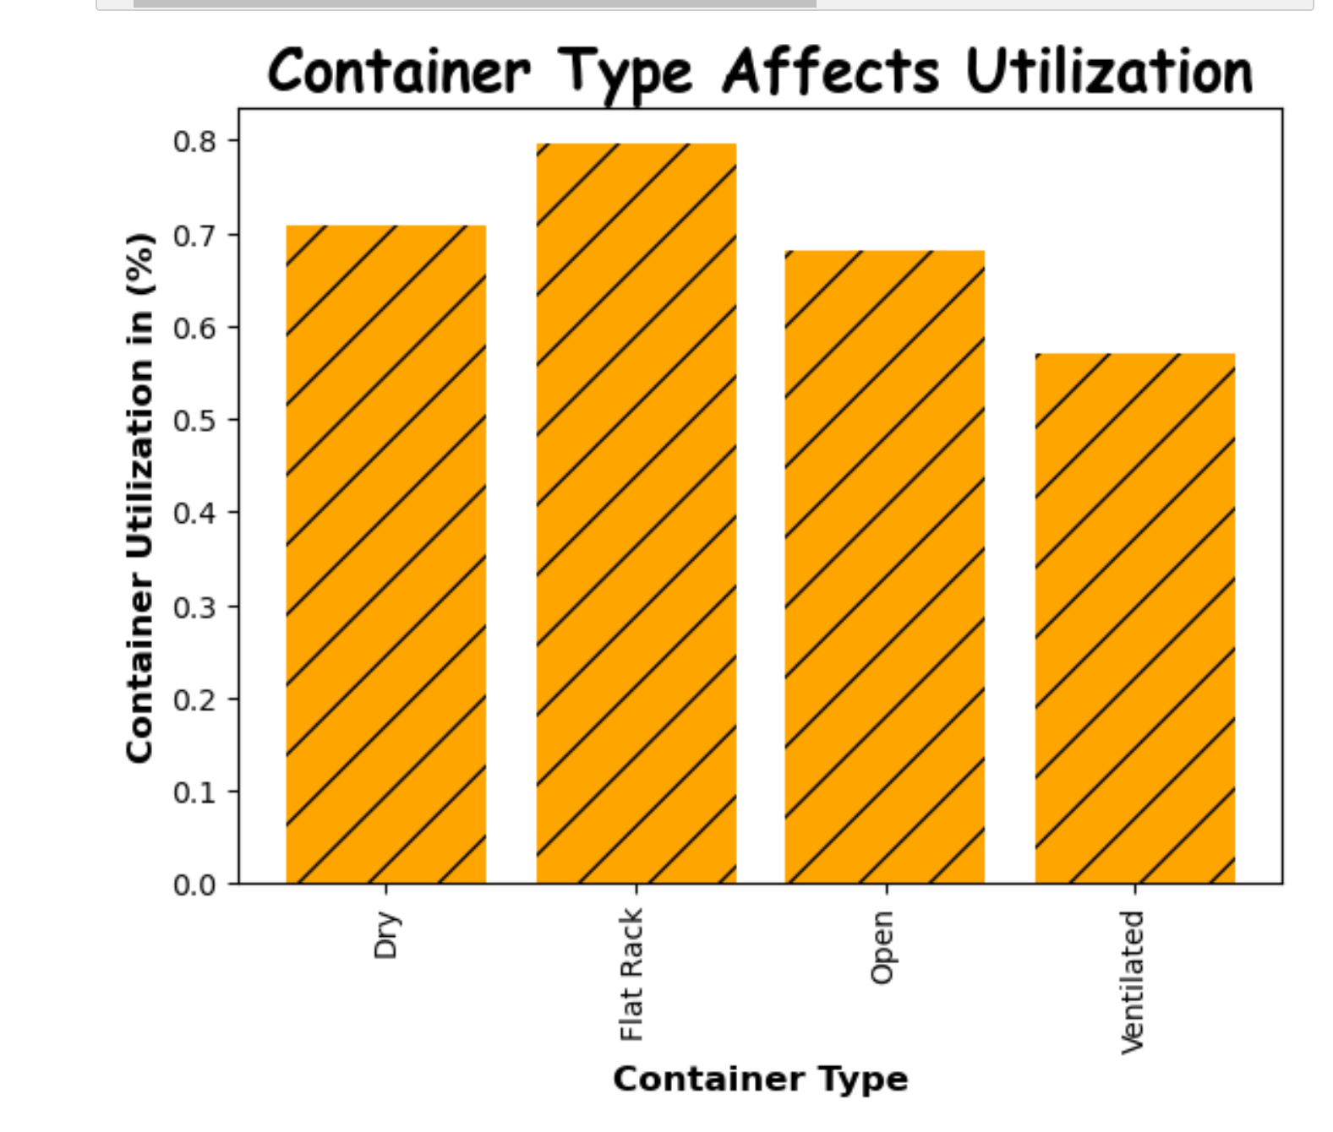

Slide 11
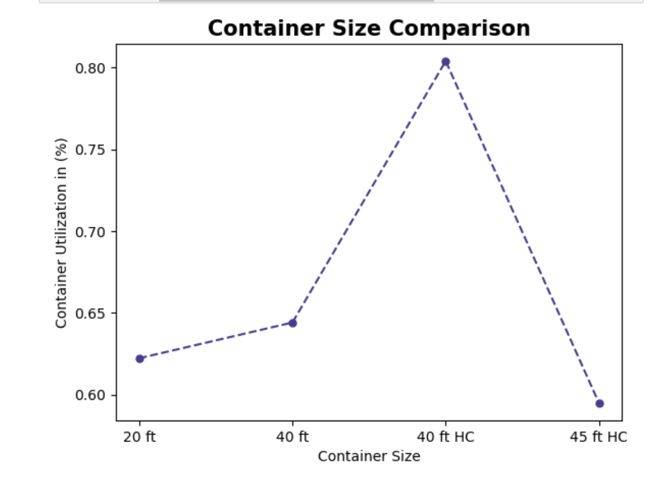
Hypothesis: The larger the container size will have a higher utilization rate

Slide 12
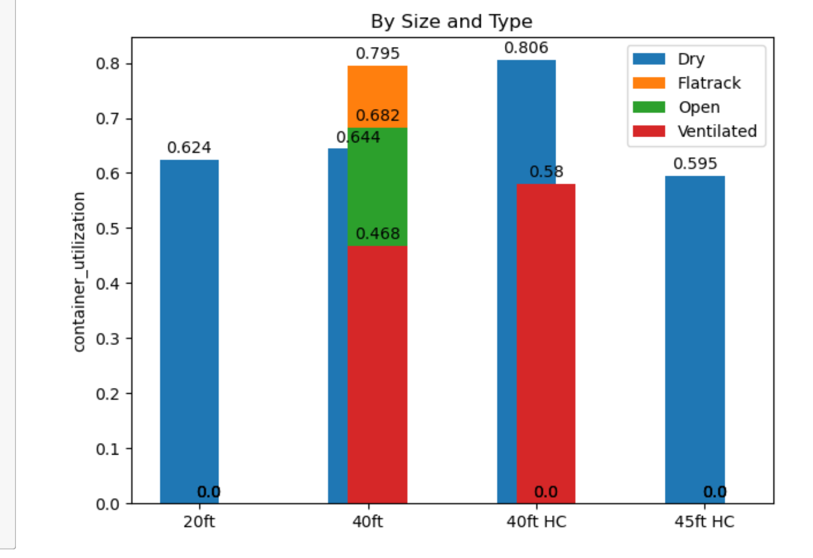
Hypothesis: 40 ft HC or flat rack container type will have the highest utilization rate

Slide 13
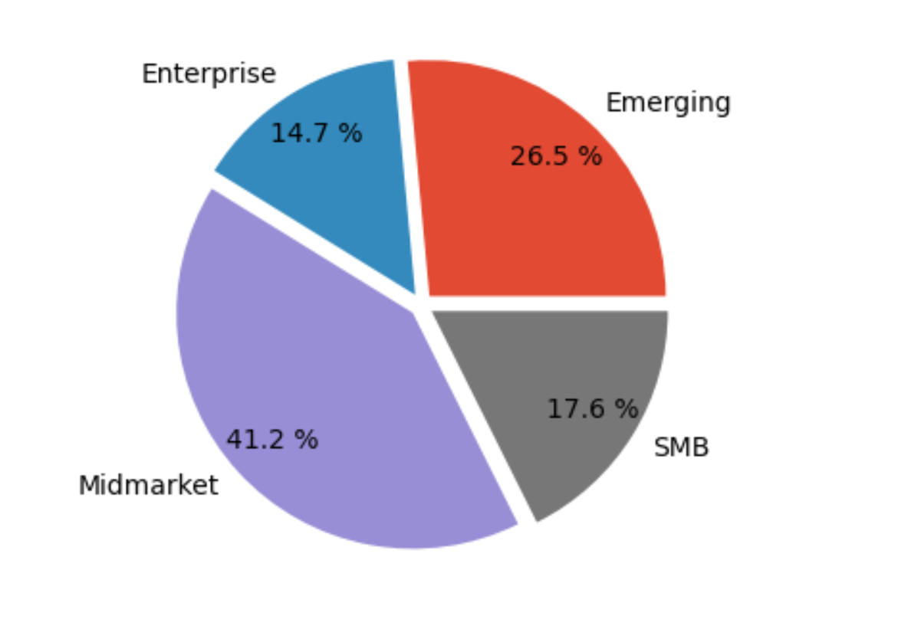
Question 4: How many companies that pay Flexport to have their Products moved from Suppliers to final destination? What's their market size/potential
There are 34 companies that pay Flexport to have their Products moved from Suppliers to final destination

Slide 14
Main Analysis on delivery and cost
Shipments dataset contains a lot of useful information to analyze on these two aspects.
However, the dataset is dirty with a lot of missing values, abnormal values and complicated data relations.
For example, the actual total Cost for the first record is zero, that'd be an data error or data inaccuracy because the shipment cost could not be zero. For these records, there are also a lot of missing data for other columns as well. Therefore, I decided to do an outlier analysis to clean the data.

Slide 15
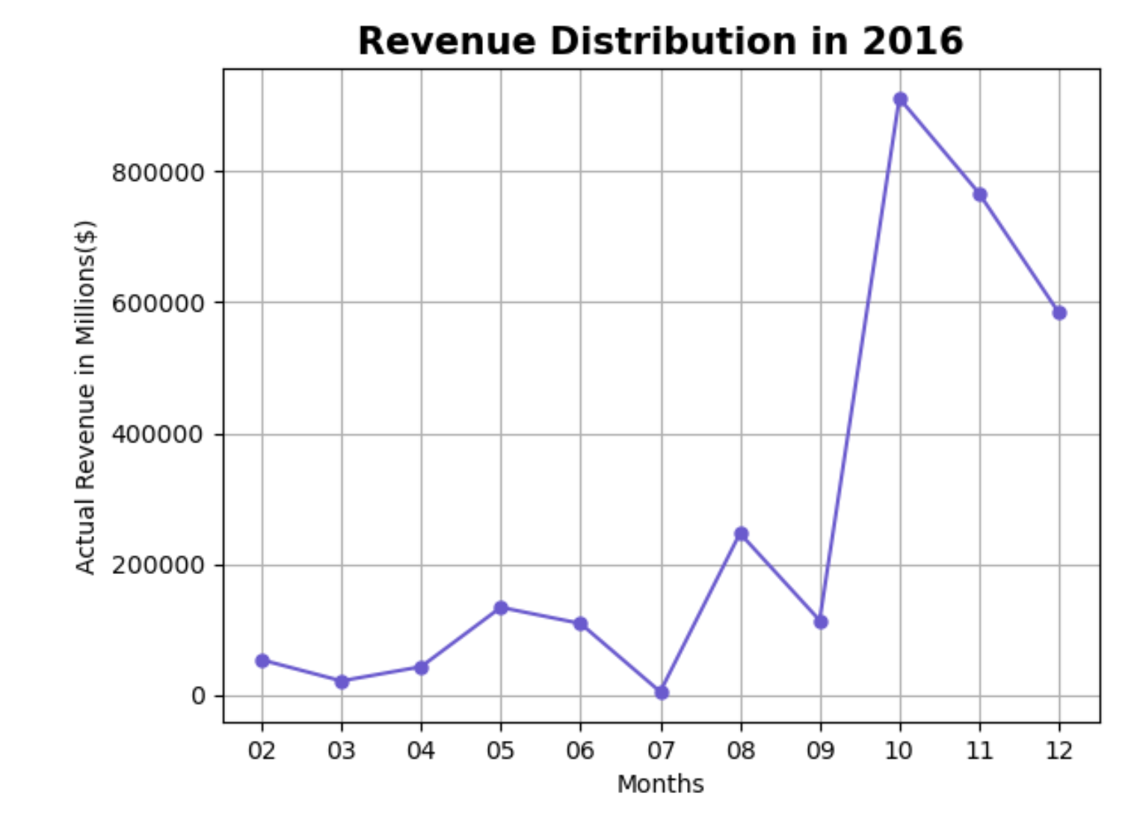
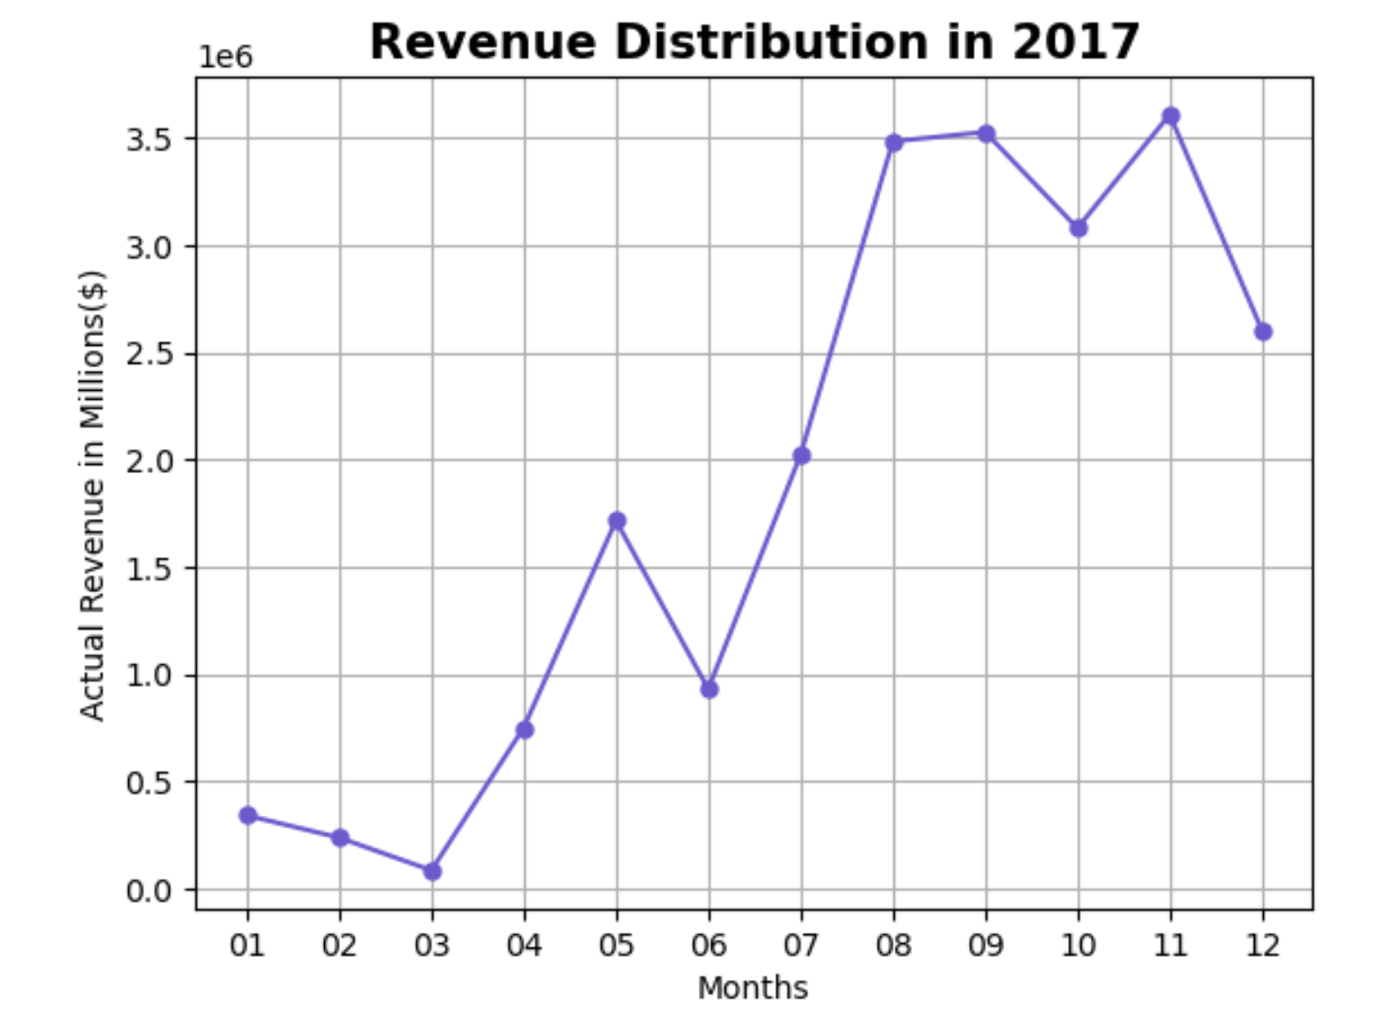
Hypothesis: The Flexport works in a transportation industry, there might be a seasonality

Slide 16
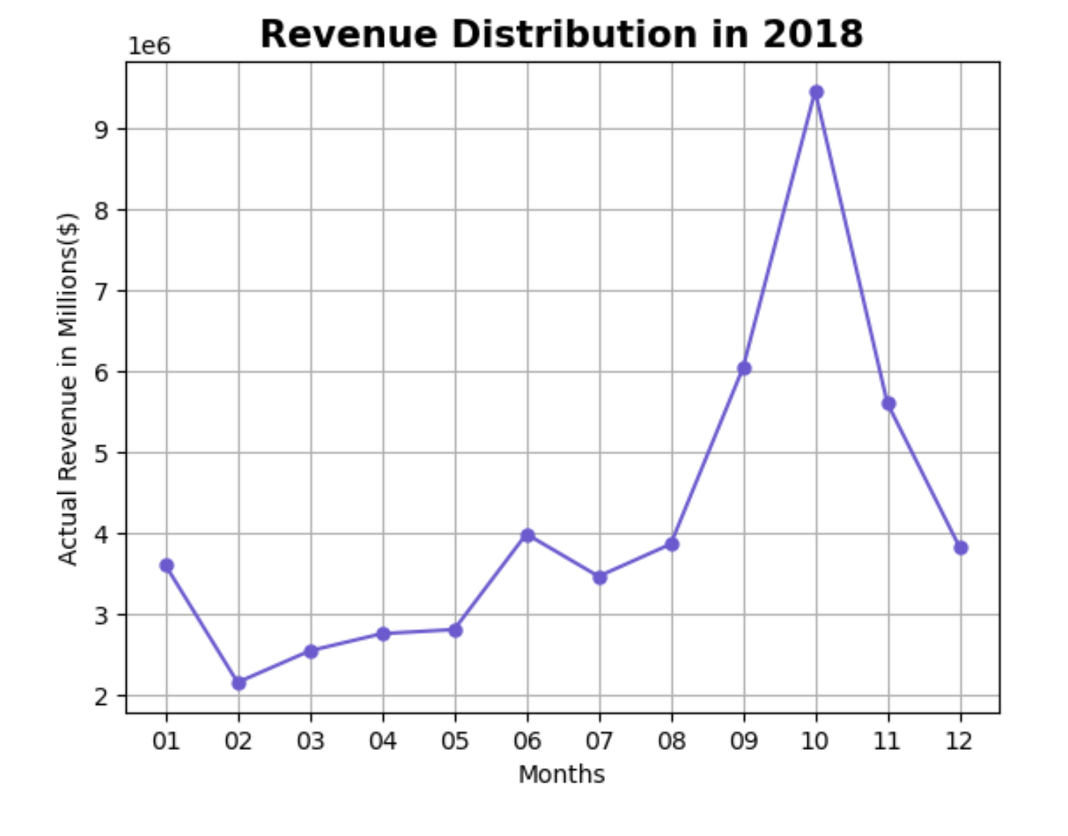
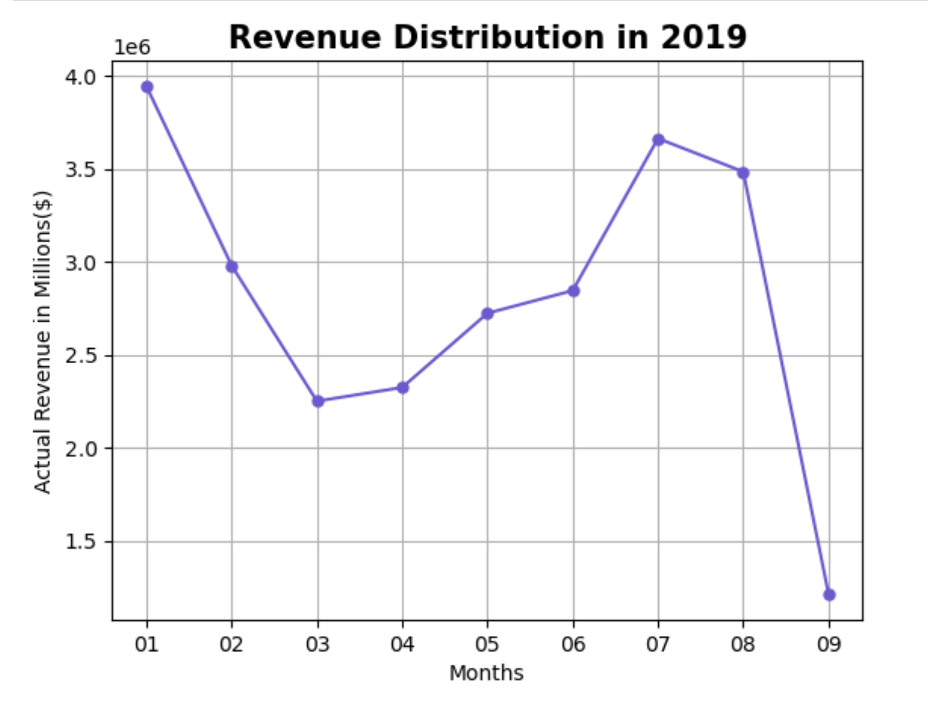

Slide 17
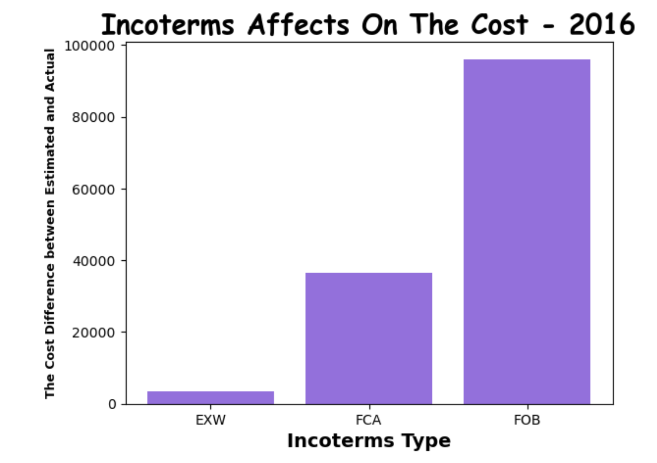
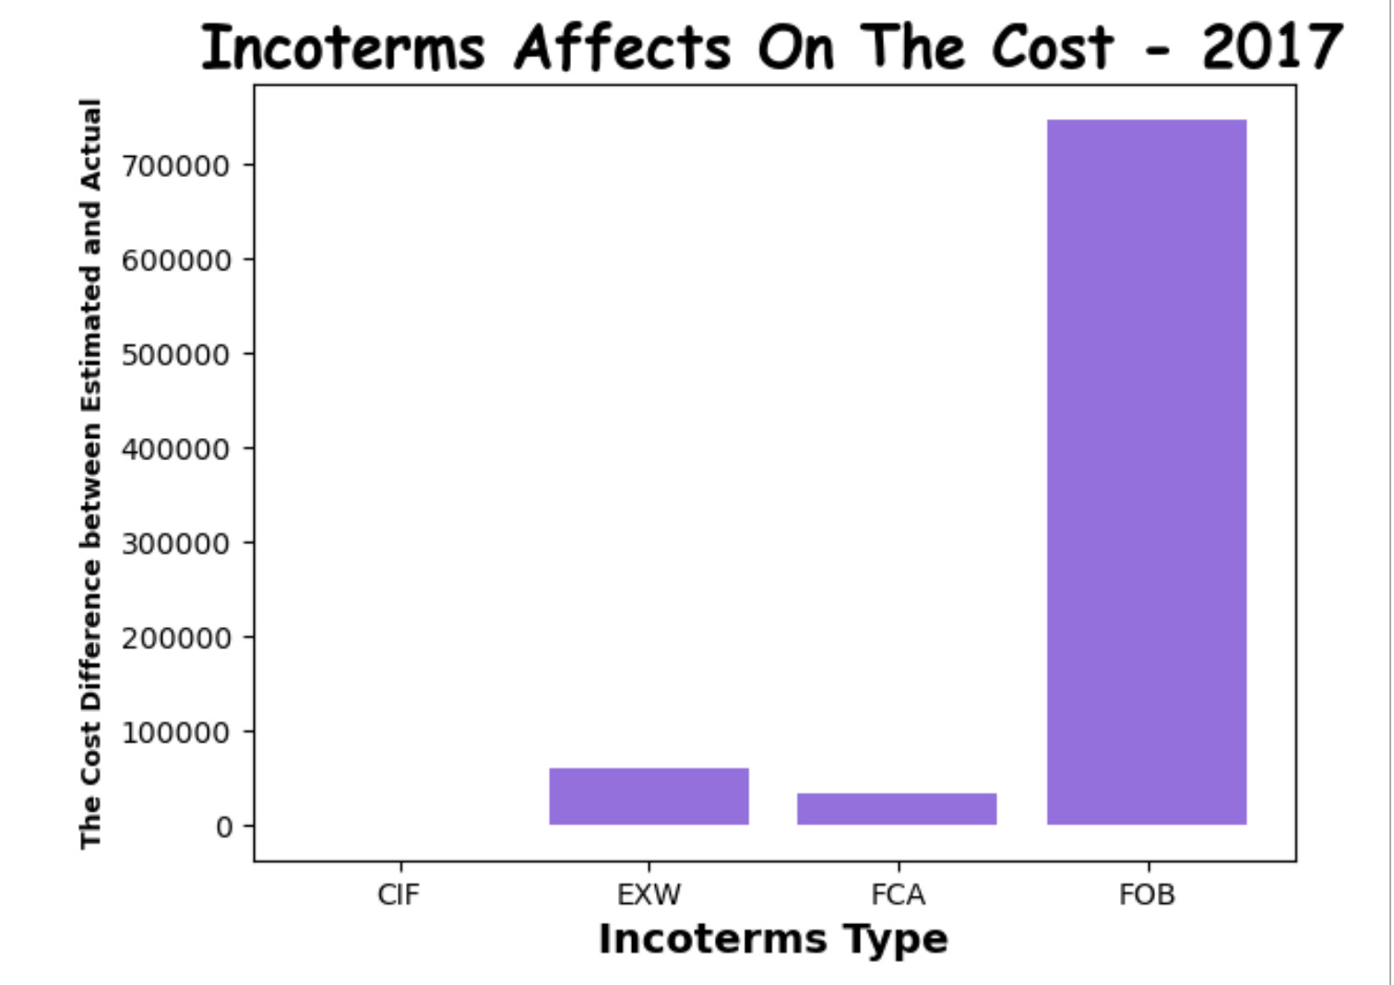
Hypothesis: the different incoterms will have different impact on the estimate cost and actual cost.

Slide 18
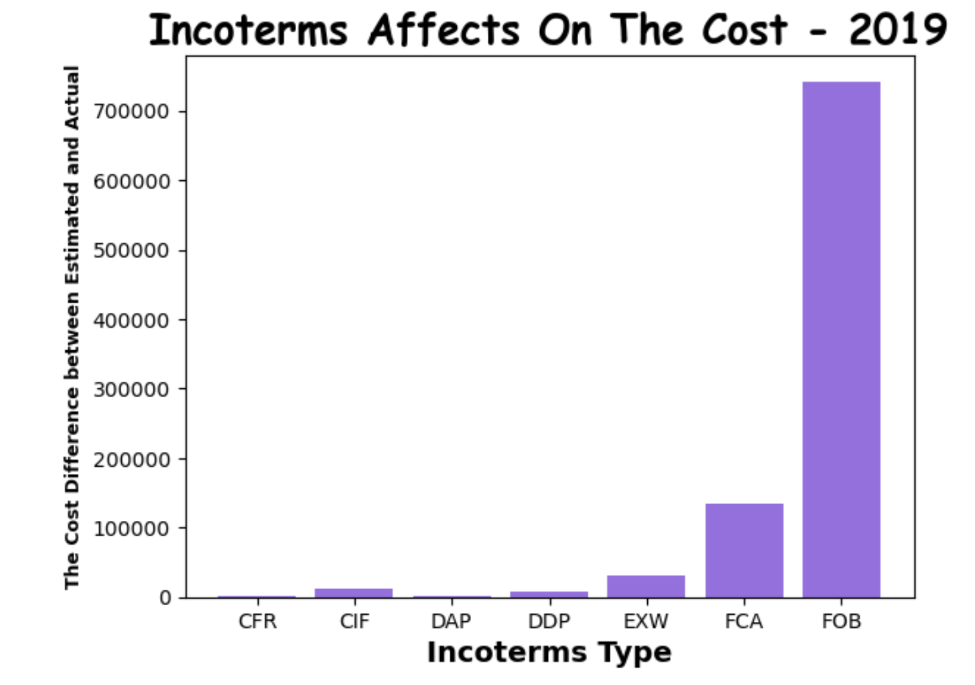
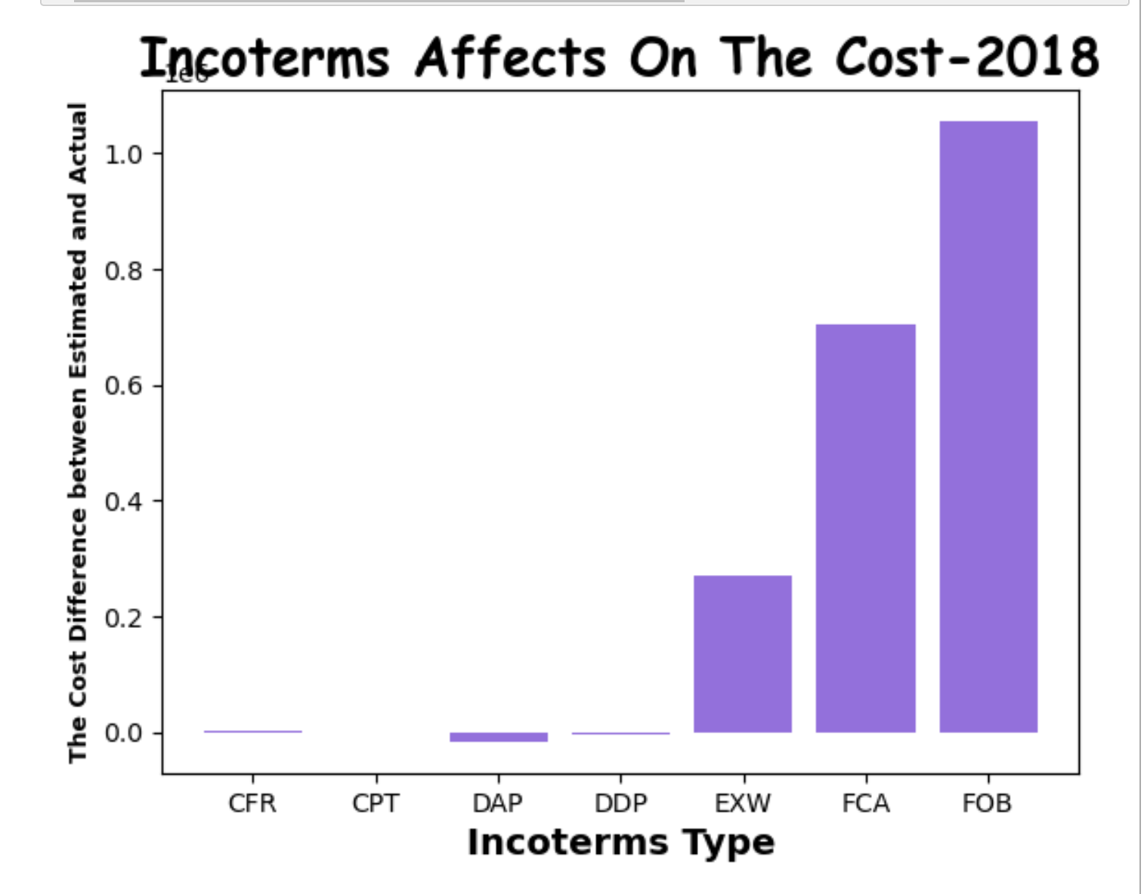

Slide 19
Question: Over the past years, is the deliveries on-time and fast?
In general, The Flexport delivery is pretty fast and on-time as always. During the 2016 to 2019, the average delivery time between estimation and actual time is actual delivery time is 12 hour 21 mins less than estimated time.

Slide 20
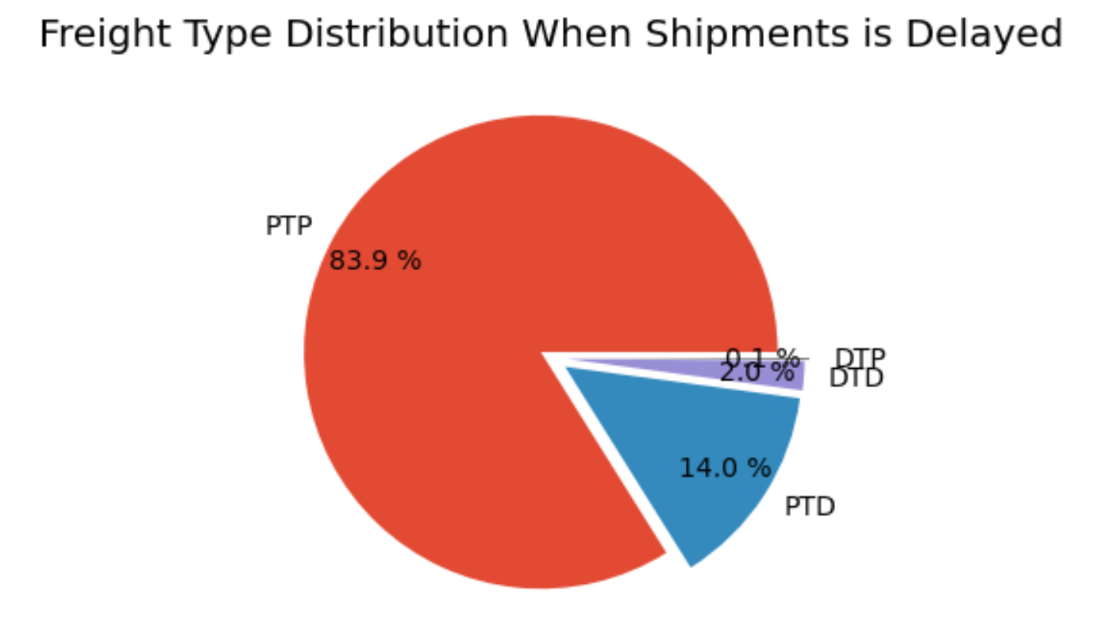
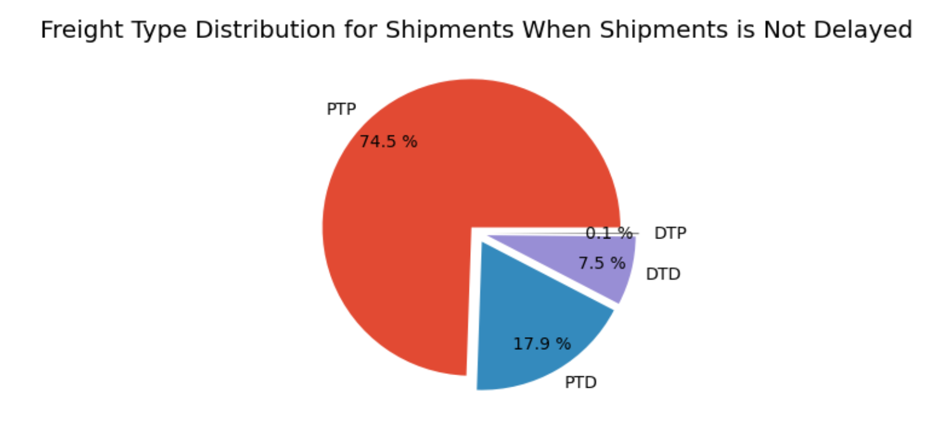
Question: What are major factors to influence the delivery time ?

Slide 21
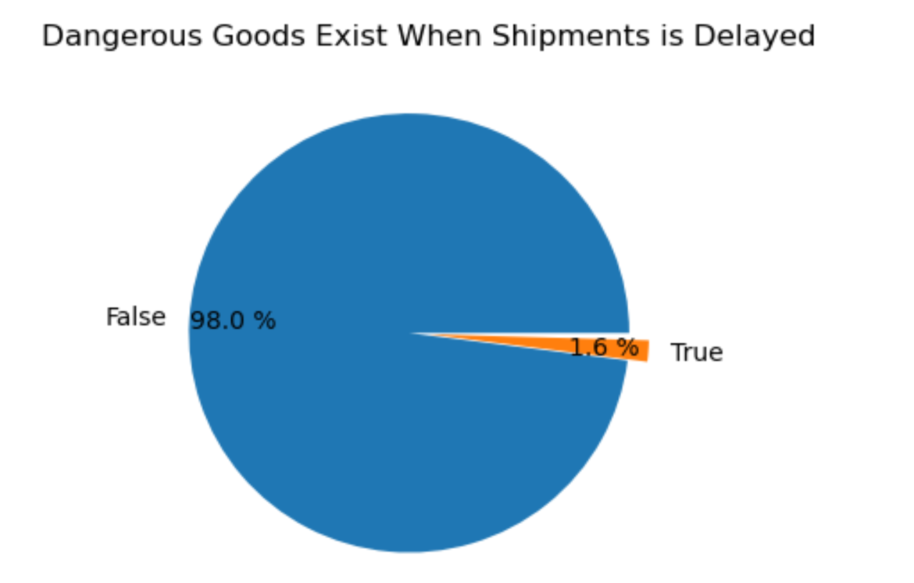
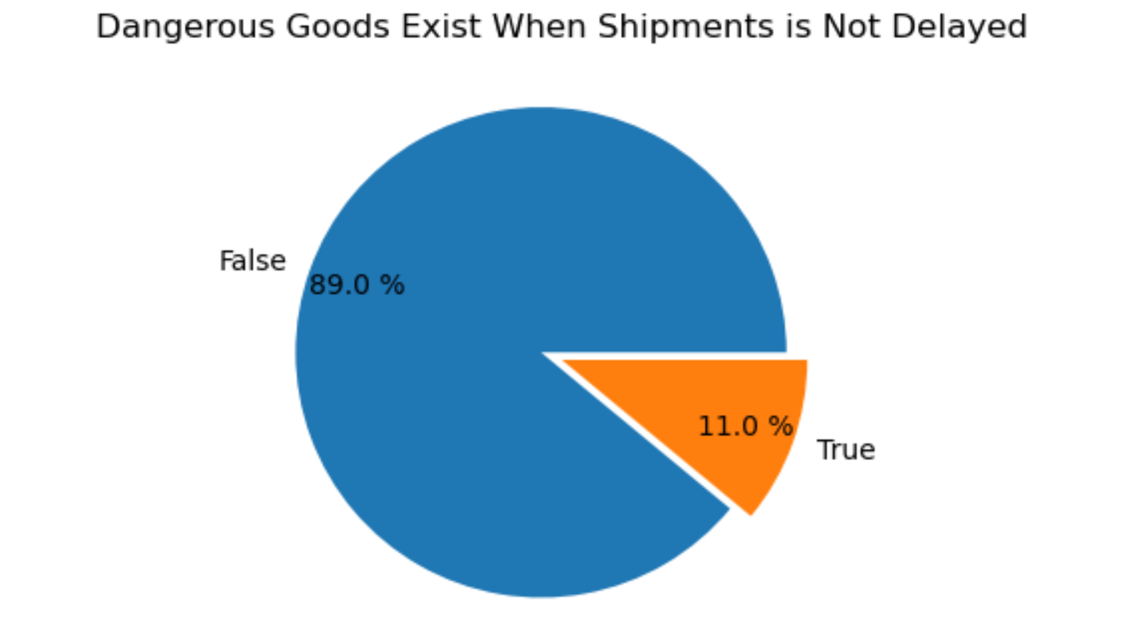

Slide 22
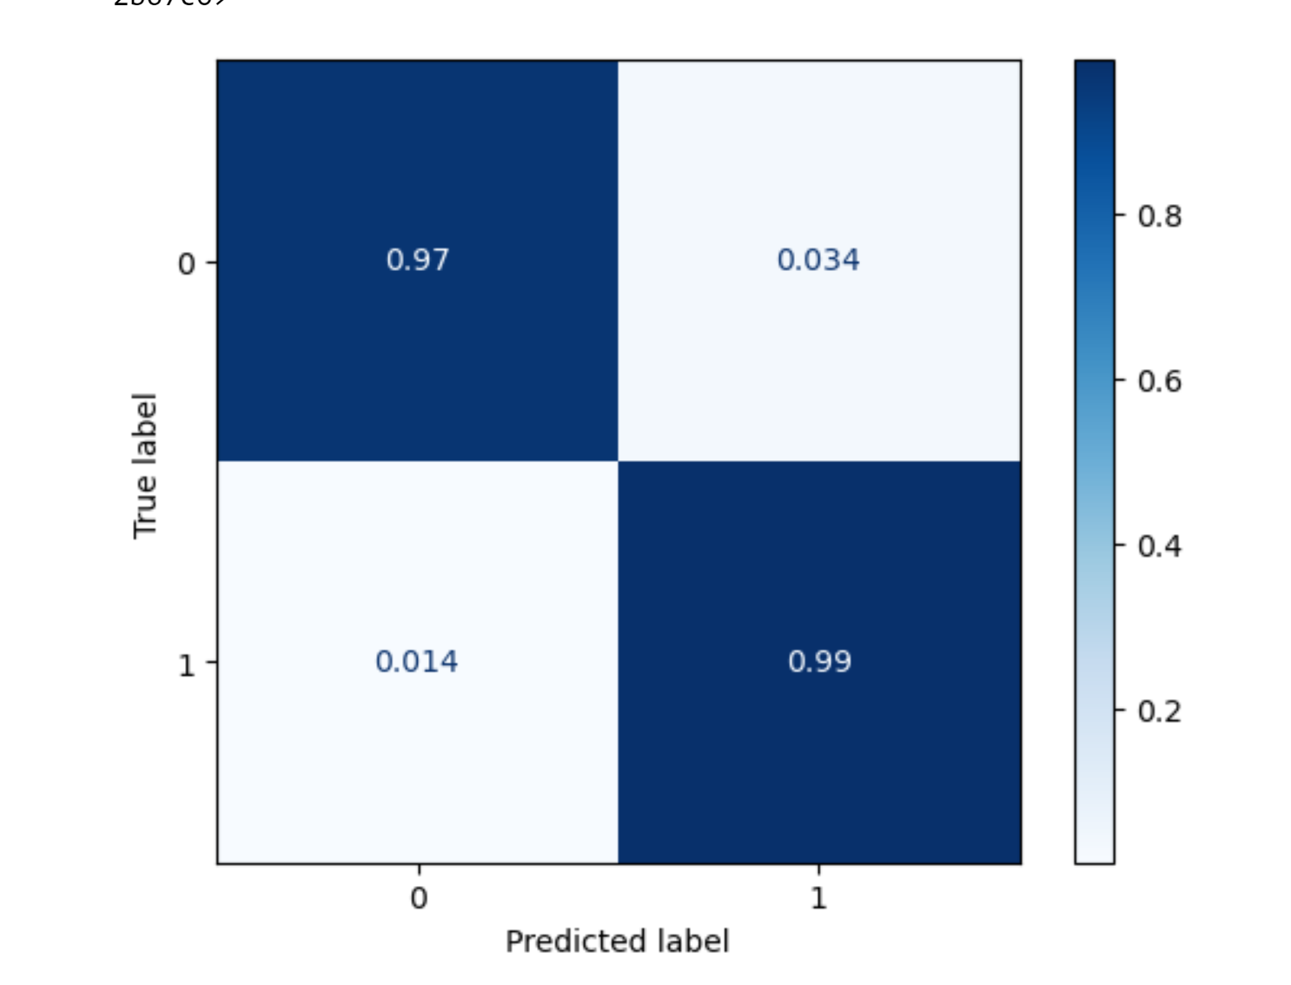
Machine Learning Model- Predict a good container

Slide 23
Summary of Findings
There are three main suppliers in the world are China, Hong Kong and United States.
The Company is growing at a fast-pace, but there might be a problem in causing the differences between estimate sales and actual sales. The company overestimated its sales in year 2017 and 2018.
Consignees are mainly mid-market firms and emerging firms. In my perspective, the growth potential is so huge in the future. We should do more marketing to attract consignees to ‘online’.
In my opinion there is a seasonality over years. From the graph, we can see that the actual revenue is higher in the second half of the year and lower in the first half. The peak is around October and November. This is an interesting obeservation because December is the last month of the year and December has a lot of holidays including Christmas and New Year.

Slide 24
Summary of Findings
FOB has the lowest actual cost for the firm, EXW has the highest actual cost.
The overall delivery speed is excellent, but try to use more PTD and less PTP will potential decrease delivery delay. Dangerous goods are sometimes a ‘good’ thing because make the delivery much faster.
Ocean shipments contains more than 55% of the total goods. The Flat Rack have the highest container utilization, the Ventilated have the smallest container utilization; 40 ft HC has the largest utilization rate, but the 45 ft HC has the lowest utilization rate. A good container size and volume along with 40 ft HC with the type of dry or 40ft with the type of flat rack will have 97% of chance to exceed 80% container utilization rate.

